Slide 1

UDP protocol and Attacks

Slide 2
What is Denial of Service Attack?
“Attack in which the primary goal is to deny the victim(s) access to a particular resource.”

Slide 3
DoS
A "denial-of-service" attack is characterized by an explicit attempt by attackers to prevent legitimate users of a service from using that service.

Slide 4


How to take down a restaurant
Restauranteur
Saboteur

Slide 5


Saboteur vs. Restauranteur
Table for four
at 8 o’clock.
Name of Mr. Smith.
O.K.,
Mr. Smith
Restauranteur
Saboteur

Slide 6
Restauranteur
No More Tables!
Saboteur

Slide 7
Denial-of-service attacks are most frequently executed against network connectivity. The goal is to prevent hosts or networks from communicating on the network. An example of this type of attack is the "SYN flood" attack

Slide 8
Categories of DOS attack
Bandwidth attacks
Protocol exceptions
Logic attacks

Slide 9
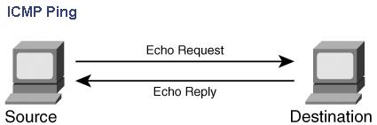
PING OF DEATH
A Ping of Death attack uses Internet Control Message Protocol (ICMP) ping messages. Ping is used to see if a host is active on a network. It also is a valuable tool for troubleshooting and diagnosing problems on a network. As the following picture, a normal ping has two messages:

Slide 10
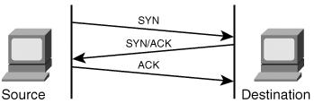
Synchronous flood
A SYN flood is one of the oldest and yet still most effective DoS attacks. As a review of the three-way handshake, TCP communication begins with a SYN, a SYN-ACK response, and then an ACK response. When the handshake is complete, traffic is sent between two hosts.

Slide 11
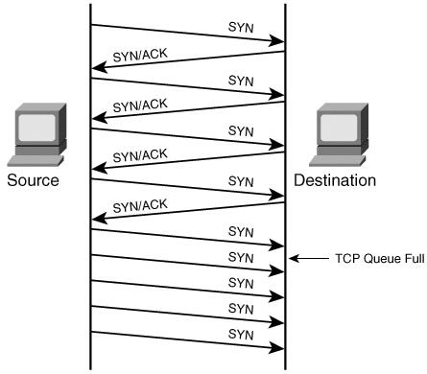
With a SYN flood attack, these rules are violated. Instead of the normal three-way handshake, an attacker sends a packet from a spoofed address with the SYN flag set but does not respond when the target sends a SYN-ACK response. A host has a limited number of half-open (embryonic) sessions that it can maintain at any given time. After those sessions are used up, no more communication can take place until

Slide 12
SYN floods are still successful today for three reasons:
1) SYN packets are part of normal, everyday traffic, so it is difficult for devices to filter this type of attack.
2) SYN packets do not require a lot of bandwidth to launch an attack because they are relatively small.
3) SYN packets can be spoofed because no response needs to be given back to the target. As a result, you can choose random IP addresses to launch the attack, making filtering difficult for security administrators.

Slide 13

An example: TCP SYN flooding
“TCP connection, please.”
“TCP connection, please.”
“O.K. Please send ack.”
“O.K. Please send ack.”
Buffer

Slide 14
Direct Single-tier DoS Attacks
Straightforward 'point-to-point' attack, that means we have 2 actors hacker and victim.
Examples
Ping of Death
SYN floods
Other malformed packet attacks

Slide 15
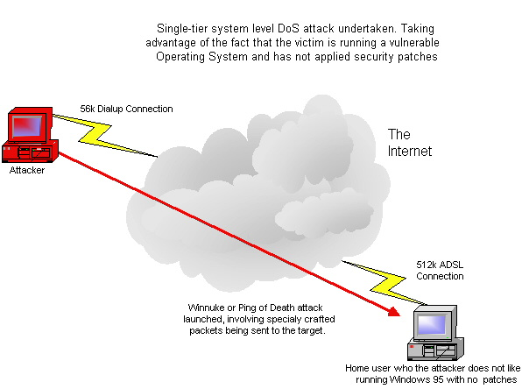

Slide 16
Direct Dual-tier DoS Attacks
More complex attack model
Difficult for victim to trace and identify attacker
Examples
Smurf

Slide 17
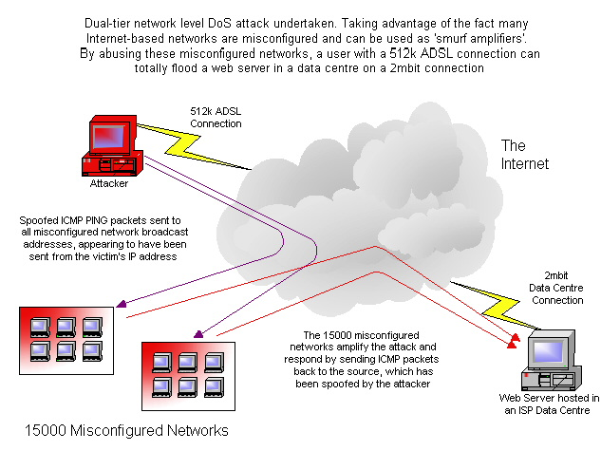

Slide 18
Direct Triple-tier DDoS Attacks
Highly complex attack model, known as Distributed Denial of Service (DDoS).
DDoS exploits vulnerabilities in the very fabric of the Internet, making it virtually impossible to protect your networks against this level of attack.
Examples
TFN2K
Stacheldraht
Mstream

Slide 19
The Components of a DDoS Flood Network
Attacker
Often a hacker with good networking and routing knowledge.
Master servers
Handful of backdoored machines running DDoS master software, controlling and keeping track of available zombie hosts.
Zombie hosts
Thousands of backdoored hosts over the world

Slide 20
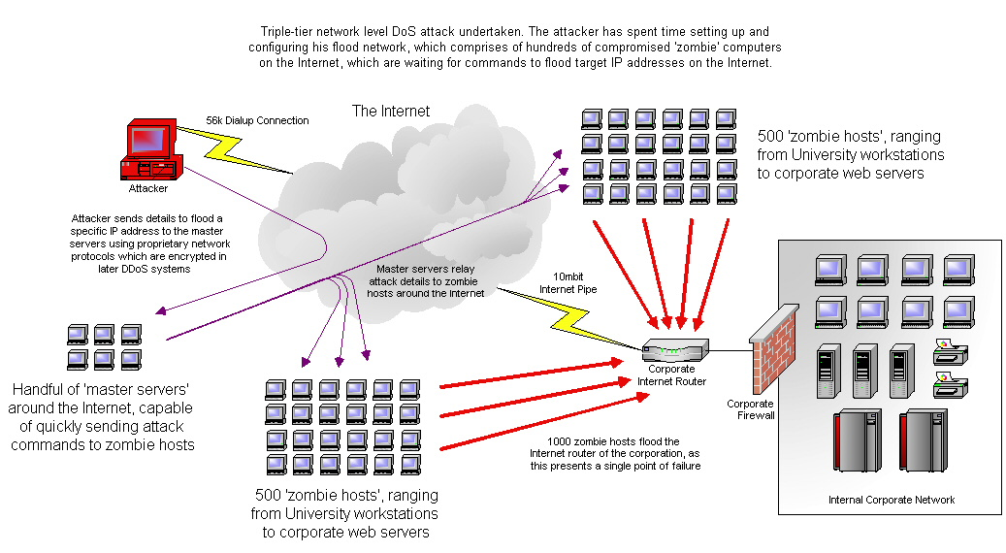

Slide 21
Distributed Denial of Service Attack (DDoS)
In and around early 2001 a new type of DoS attack became rampant, called a Distributed Denial of Service attack, or DDoS.
In this case multiple comprised systems are used to attack a single target.
The flood of incoming traffic to the target will usually force it to shut down.
Like a DoS attack, In a DDoS attack the legitimate requests to the affected system are denied.
Since a DDoS attack it launched from multiple sources, it is often more difficult to detect and block than a DoS attack.

Slide 22
Results expected
Denial-of-service attacks can essentially disable your computer or your network. Depending on the nature of your enterprise.
Some denial-of-service attacks can be executed with limited resources against a large, sophisticated site. This type of attack is sometimes called an "asymmetric attack."
For example, an attacker with an old PC and a slow modem may be able to disable much faster and more sophisticated machines or networks.

Slide 23
Thank You

